Slide 1
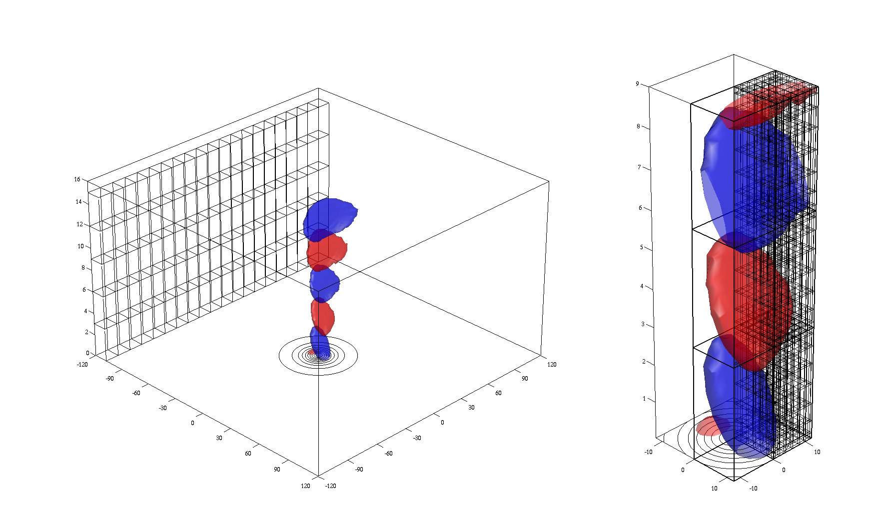

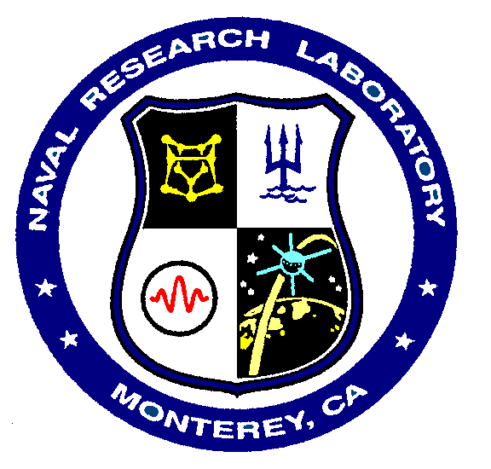
A Multiscale Non-hydrostatic Atmospheric Model for Regional and Global Applications
James D. Doyle¹, Frank Giraldo², Saša Gaberšek¹
¹Naval Research Laboratory, Monterey, CA, USA
²Naval Postgraduate School, Monterey, CA, USA

Slide 2
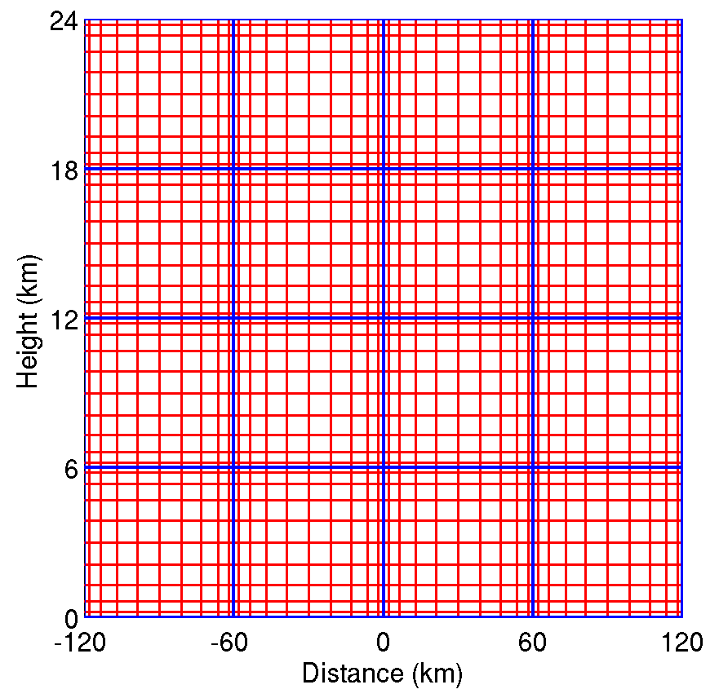
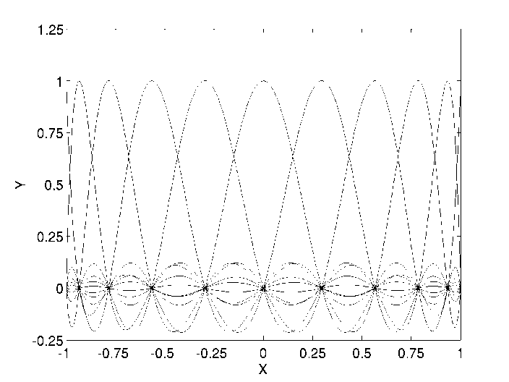
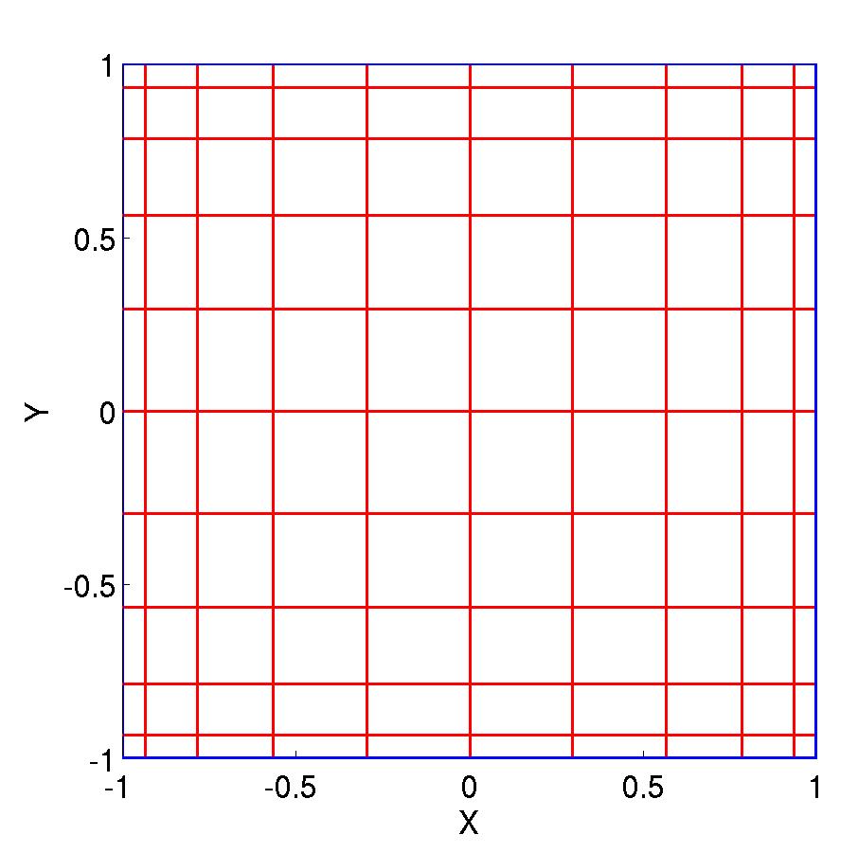
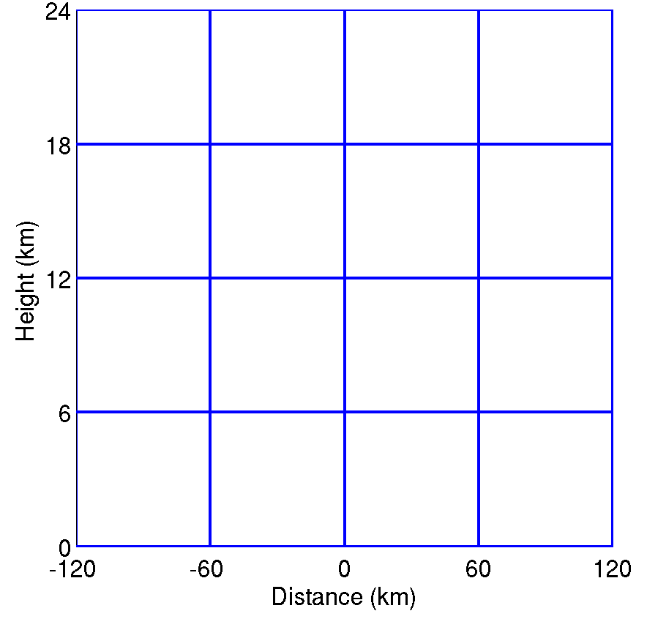
Motivation
Emerging need for next-generation models that are highly scalable and can be used across scales for Earth System Modeling.
Our goal is to develop and evaluate a new Element Based Galerkin (EBG) modeling framework, Non-hydrostatic Unified Model of the Atmosphere (NUMA), with the following capabilities:
  Multi-scale non-hydrostatic dynamics (global-scale to mesoscale)
  Flexible, accurate, and conservative numerical methods
  Highly scalable
  Structured, unstructured or adaptive grids with sub-grid scale physical parameterizations that are “scale-aware”
  Flexible to enable earth system modeling (e.g., integrated, coupled)
Elements (4x4)
10th order polynomial
Nodal points
Basis Functions

Slide 3
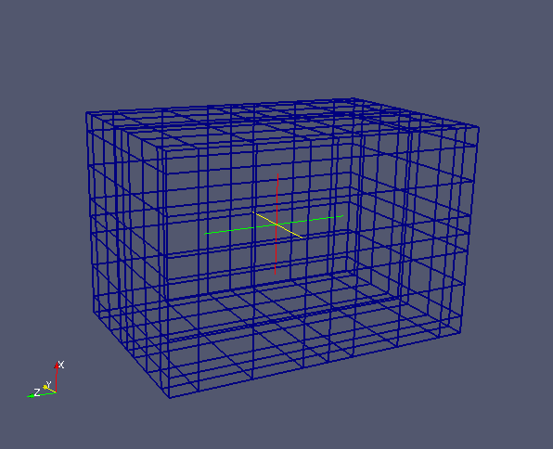
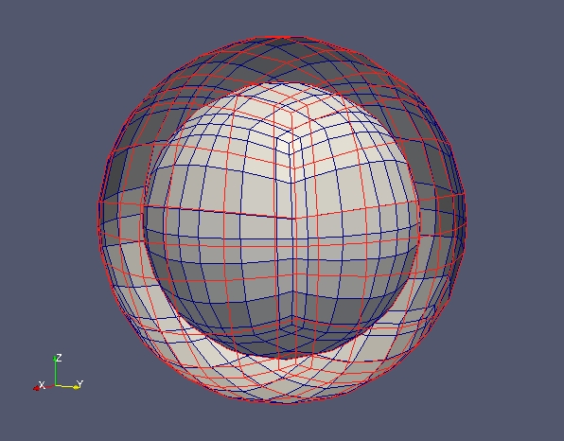
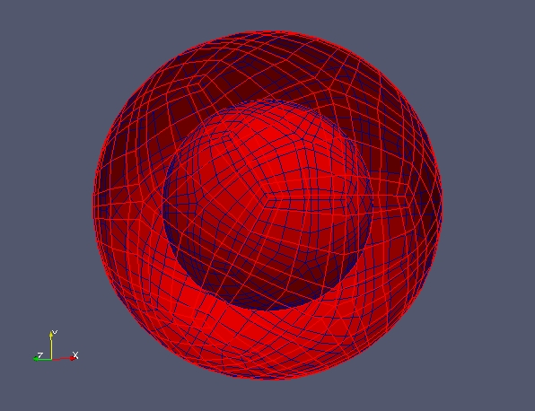
NUMA Grid Mesh Examples
Mesoscale Modeling Mode
Global Modeling Mode
(Cubed-Sphere)
Global Modeling Mode
(Icosahedral)
Telescoping Grid
ITCZ Grid
Notes:
Any grid can be used within NUMA provided that it is based on hexahedra (cubes). So as long as the 2D grid looks like quadrilaterals then we are good to go. The only caveat, though, is that the grid needs to be a quad in 2D (hexahedron in 3d). While we have considered making the grids triangles (in 2D) and triangular prisms (in 3D) we see this approach not as attractive because the quad/hexahedra based codes are much faster due to the tensor-product structure of the grid (3d hexahedra is nothing more than a series of 3 1d problems).
I'm certainly open to other grids but currently we see many advantages of the cubed-sphere grid. For example, comparing the icosahedral versus cubed-sphere (CS) grid we see better accuracy with the CS for the same number of DOFs.
This can be attributed to most problems we have run having the flow aligned with the CS grid whereas with the Icosahedral grid, the flow cuts across the cells at various angles.
Although our AMR technique does not rely on the CS grid, we see this grid giving us a more optimal quadrilateral grid (on the surface of the sphere).

Slide 4
NUMA Scalability
Both Continuous Galerkin (CG) and Discontinuous Galerkin (DG) methods scale well up to 8,000 processors. DG method scales up to 32,000 processors.
Each processor contains only one single element which illustrates the fine-grain parallelism of both methods.
Scales well on GPU architecture (DG).
Kelly and Giraldo (2012)
Notes:
At 32,000 procs, the DG result has one element per processor. Pretty Amazing!

Slide 5
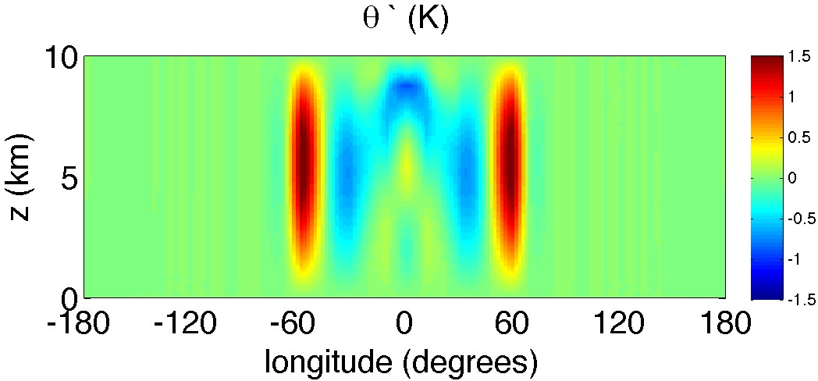
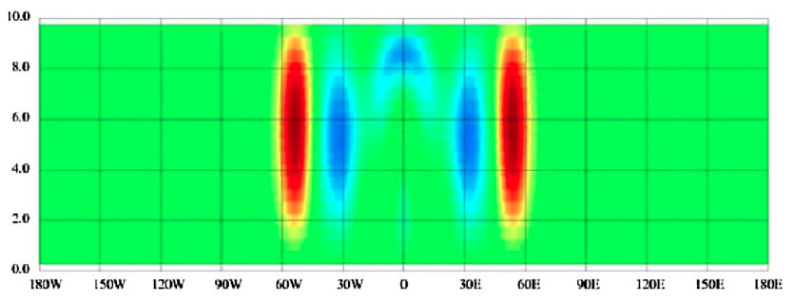
Inertia-Gravity Wave Propagation
(N=0.01, T=48 hours)
NUMA
Grid
Theory=32 m/s,
NUMA model=33 m/s, NICAM model = 33 m/s
NICAM
NUMA has been successfully demonstrated for many 2-D and 3-D test cases.
3D inertia-gravity wave test case agrees well with theory.
Notes:
Resolution=240 km (horizontal) x 0.5 km (vertical)
Top figure: is N=0.01 (cg=31.83 m/sec, NUMA model=33 m/sec, NICAM model == 33 m/sec.
In 48 hours travels 5500km)
Cg=(N z_top)/(pi n_v) n_v=1 here.

Slide 6
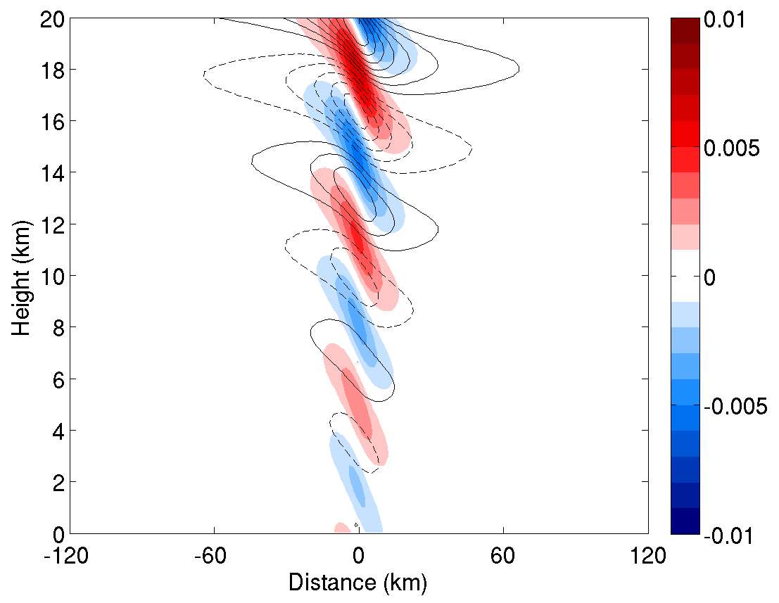
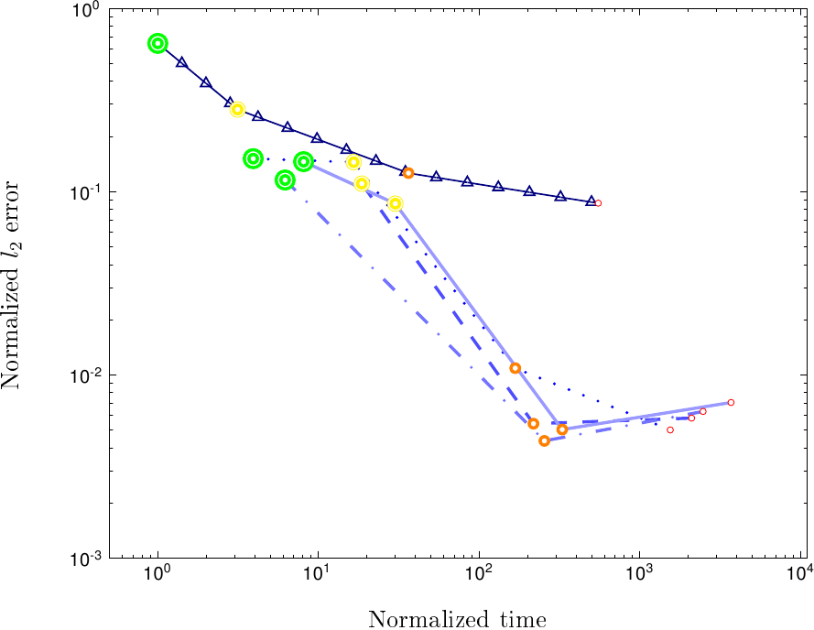
2-D Linear Hydrostatic Wave
p=4 (dot)
p=6 (dash-dot)
p=8 (dash)
p=10 (solid)
Δx= 3.0 km
Δx= 2.0 km
Δx= 1.0 km
Δx= 0.5 km
Finite Difference
Efficacy, defined as accuracy over cost, favors the NUMA approach, even in this serial implementation.

Slide 7
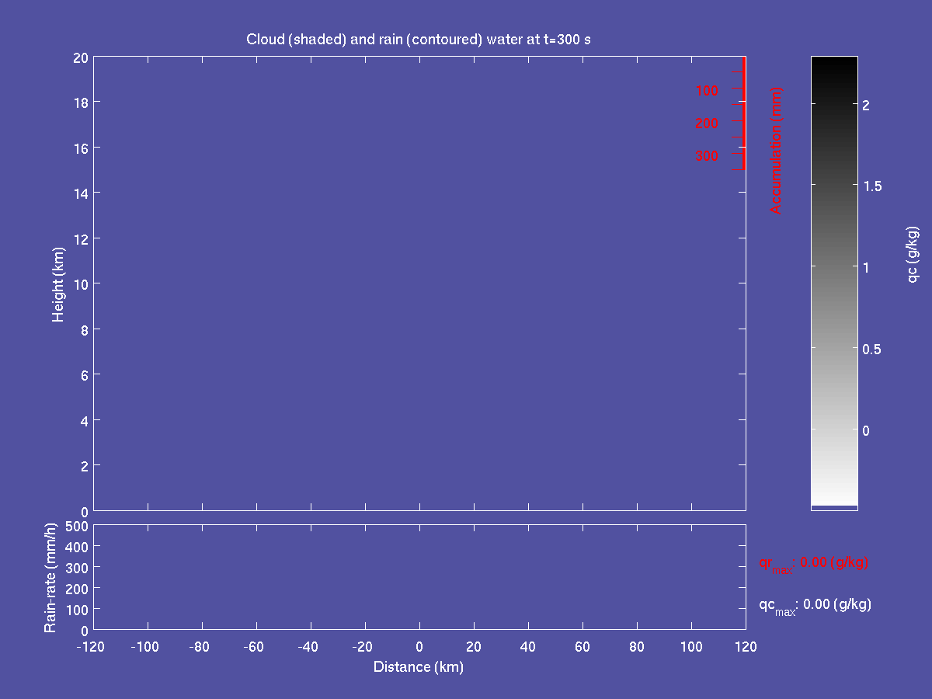
Incorporation of Physical Processes
Surface Fluxes, Boundary Layer, Vertical Diffusion
Momentum, sensible, latent heat fluxes
Addition of land surface databases (underway)
Microphysics
Warm, Kessler-type currently implemented
Cumulus parameterization
Deep cumulus for coarser resolution
Shallow convection (underway)
Scale-aware attributes
Radiation
RRTM (underway)
Future
Chemistry, aerosols, advanced microphysics
Land surface and hydrology
Generalized physics interface
Air-ocean-wave-ice coupled physics

Slide 8
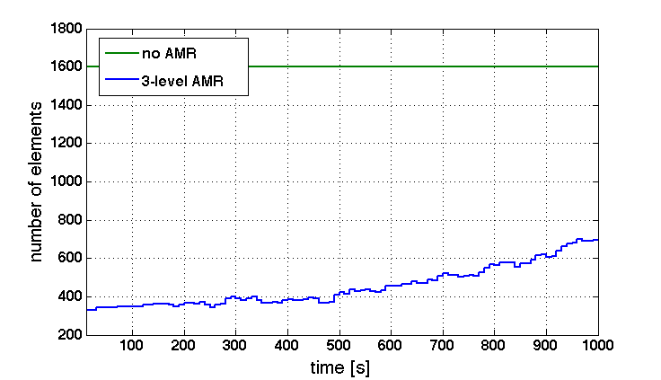
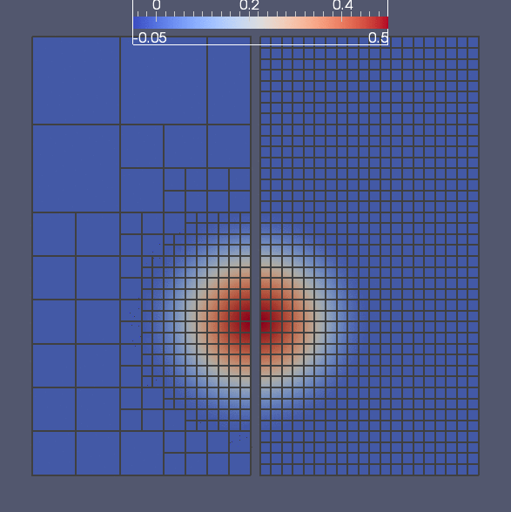

Kopera and Giraldo JCP (2013)
Non-conforming Adaptive Mesh Refinement
Non-conforming adaptive mesh refinement capability can increase efficiency.
Possible applications: tropical cyclones, dispersion, urban, coastal, severe storms…

Slide 9
Summary and Future Directions
NUMA Development and Evaluation:
  Attributes
    highly accurate and conservative dynamical core
    excellent scalability on massively parallel computers
    flexible dynamical core for global or local area problems
  Extensive testing and evaluation already performed
  Possible next generation model for U.S. Navy, candidate for ESPC.
  Prototype for Korea’s next-generation global model
  NUMA selected by Argonne National Lab as flagship application for PETSc (winner of prestigious DoE Lawrence Award).
Future Directions:
  Incorporation of full physics for global & mesoscale (underway)
  Real case applications in 1QFY14, “routine” runs in 1QFY15
  Coupling to waves, ice, ocean
  DG, unstructured and adaptive mesh options
Notes:
PETSC=Portable Extensive Toolkit for Scientific Computing

Slide 10
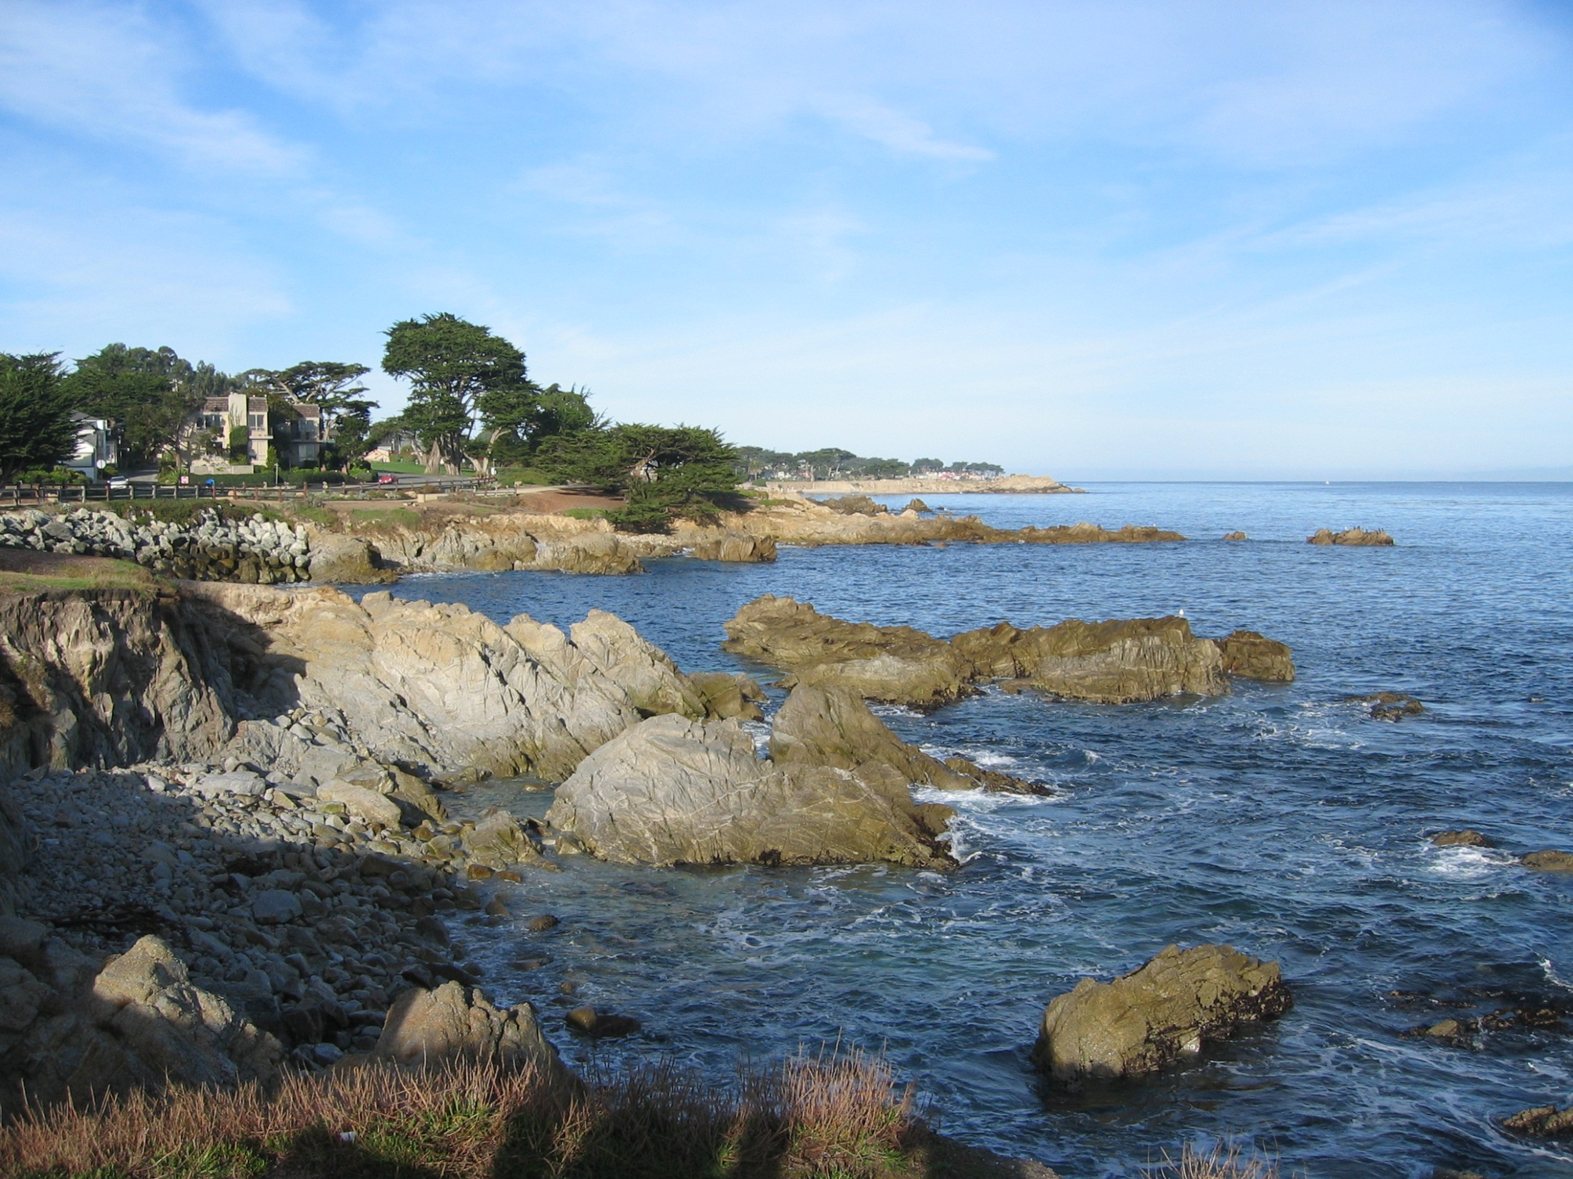
QUESTIONS?

Slide 11
NUMA Collaborators
Model Development
Michal Kopera, Applied Math, Naval Postgraduate School
Andreas Müller, Applied Math, Naval Postgraduate School
Shiva Gopalakrishnan, Indian Institute of Technology (Bombay)
Jim Kelly, Exa Corporation
Physical Parameterization and Coupling
Naval Research Laboratory (Monterey)
Simone Marras, Barcelona Supercomputing Center
Time-Integrators
Emil Constantinescu, Argonne National Laboratory
Dale Durran, University of Washington
Preconditioners
Carlos Borges, Applied Math, Naval Postgraduate School
Les Carr, Applied Math, Naval Postgraduate School
Notes:
PETSC=Portable Extensive Toolkit for Scientific Computing

Slide 12
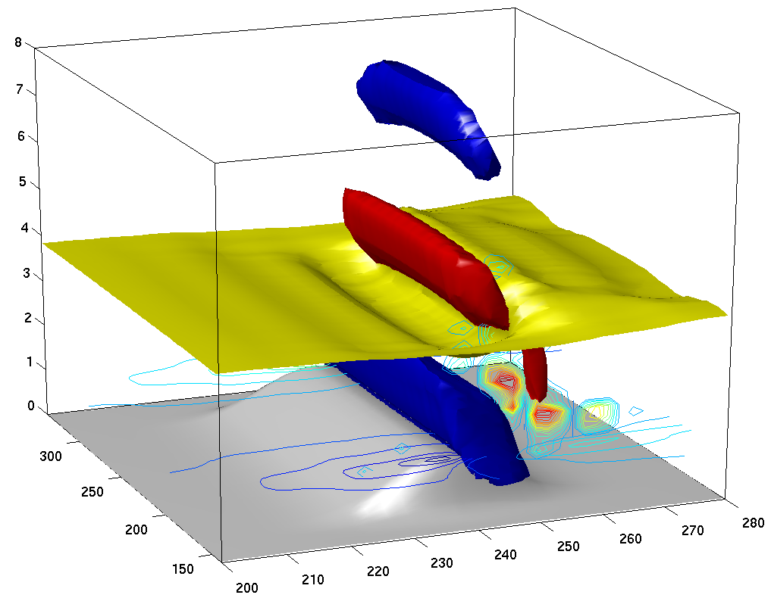
3-D Non-Linear Gravity Wave
ϑ=290 K (yellow)
w=+2 ms⁻¹ (red)
w=-2 ms⁻¹ (blue)
v(z=1 km), c.i. 2.5 ms⁻¹
K_{m}(y=190 km), c.i. 2.5 m²s⁻¹
topography (gray)
3D nonlinear gravity wave with wave overturning and vertical mixing.
Notes:
Resolution: 2400x2400x480 meters
Domain: 240,000 x 240,000 x 24,000 meters

Slide 13
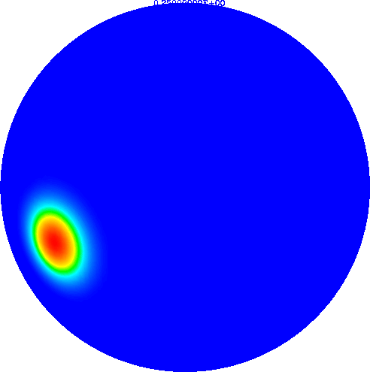

3-D Acoustic (Lamb) Wave Propagation
Potential Temperature
for T=[0,12] hours
Theory=347 m/s,
NUMA model=347 m/s, NICAM model = 338 m/s
3D acoustic (Lamb) wave propagation test case agrees well with theoretical expectations.
Notes:
Theoretical speed of sound = 347 m/sec: sqrt(gamma R T) T=300 K
Model speed of sound = 347 m/sec (32 hours to travel 2*pi*R where R=6371 km)

Slide 14
Incorporation of Physical Processes
Physical parameterization implementation
Interface for basic differential operators (gradient, divergence, curl, laplacian), with analytic derivatives as opposed to FD method
Fortran module mod_interface.f90
Example
subroutine stability(n,q)
use mod_grid,only: npoin
use mod_constants,only: gravity
use mod_interface,only: compute_gradient
implicit none
real :: n(npoin),q(npoin)
real :: dthetadz(npoin),grad_q(3,npoin)
call compute_gradient(q,grad_q)
dthetadz=grad_q(3,:)
n=sqrt(gravity/theta*dthetadz)
end
Include the module and relevant operator(s)
Call the relevant operator

Slide 15
Non-hydrostatic Unified Model of the Atmosphere (NUMA)
Spatial discretization for Element Based Galerkin (EBG) methods
Based on sharing of nodal points between adjacent elements
Both methods are being developed within the Non-hydrostatic Unified Model of the Atmosphere (NUMA) framework
Both methods have excellent scalability characteristics because only minimal communication is needed
Continuous Galerkin (CG) | Discontinuous Galerkin (DG)
Notes:
added fluxes for DG. For CG the communication stencil is a based on vertex neighbors. That is, any element that shares a vertex is part of the communication stencil so that for a 3x3 rectangular grid, the middle element communicates with the 8 neighboring elements whereas for DG we can cut that down to the 4 edge neighbors.

Slide 16
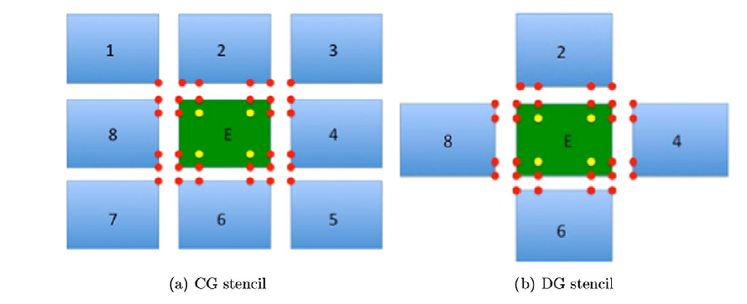
Computational Stencil for CG and DG
CG requires nodal information from 8 neighbors
DG only requires information from its 4 face neighbors
Kelly and Giraldo (2012)
Notes:
The 2D stencil figure is interesting because it shows how different CG and DG can be – this difference gets greater in 3D.
E.g., in 2D a quad element has 8 vertex neighbors and only 4 face neighbors (factor of 2 difference). In 3D a hexahedron has 26 vertex neighbors but only 6 face neighbors (factor of 4 difference).

Slide 17
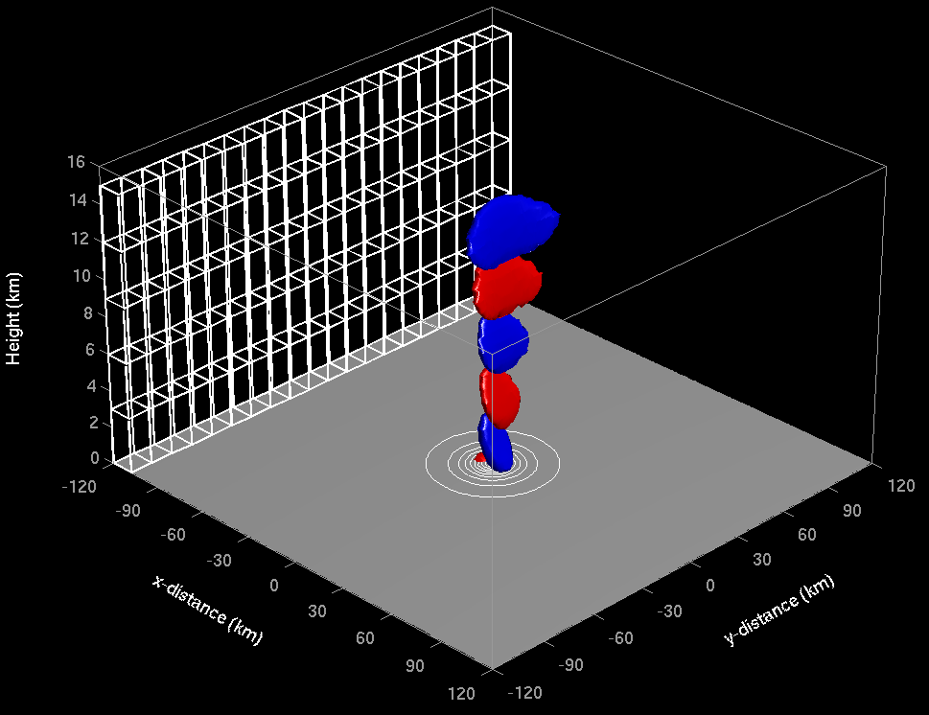
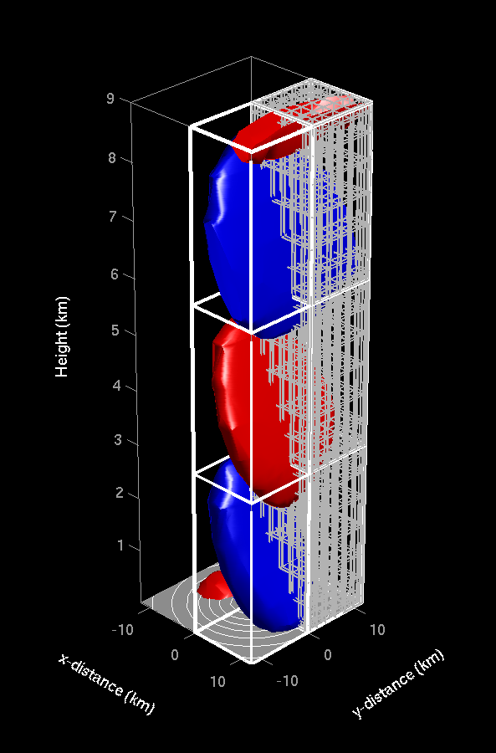
3-D Linear Hydrostatic Wave
Zoom of 3-D Hydrostatic Wave
Nodal Points
Element
3-D linear hydrostatic wave test is nearly identical to the analytic solution for both CG and DG applications.

Slide 18
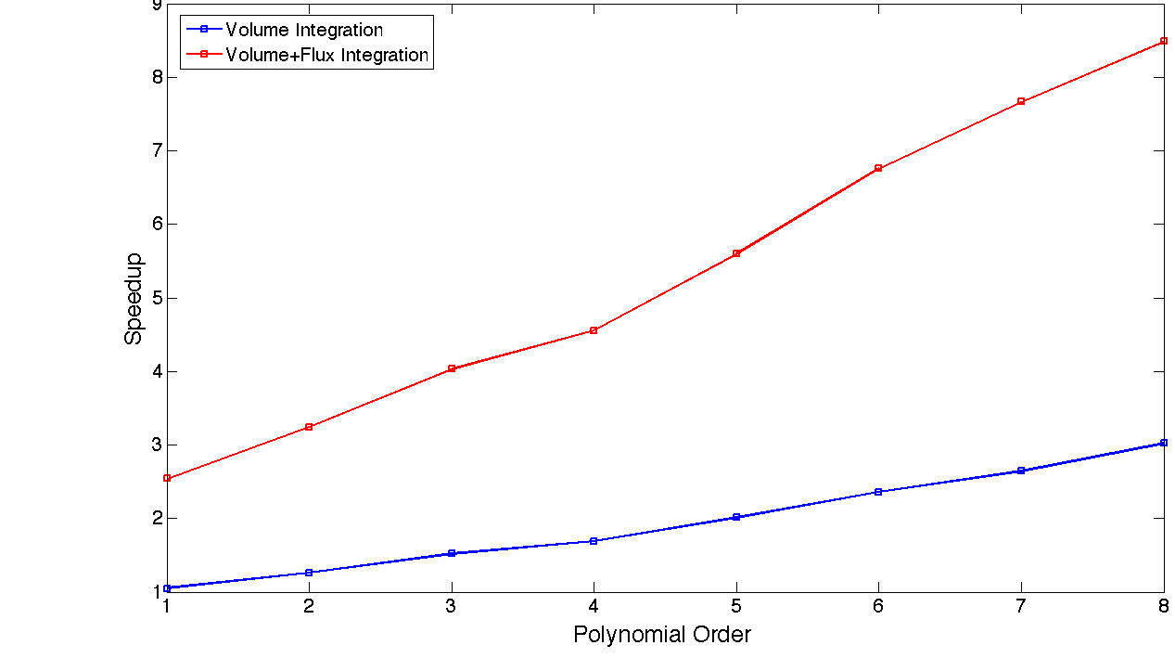
GPU-based Scalability of DG
GPU Speedup
Multi-threading of the volume integrals (local operations) and the flux integrals (DG communication) leads to better performance on GPUs
Gopalakrishnan and Giraldo (2012)
Notes:
For DG, we can multi-thread (Cudafy) the volume integrals (that are completely local operations) and the Flux integrals (where the DG method communicates). Here, we show what the gain is when we only do the local operations (blue lines: volume integrals) and both the local and neighbor operations (red line: volume + flux integrals).

Slide 19
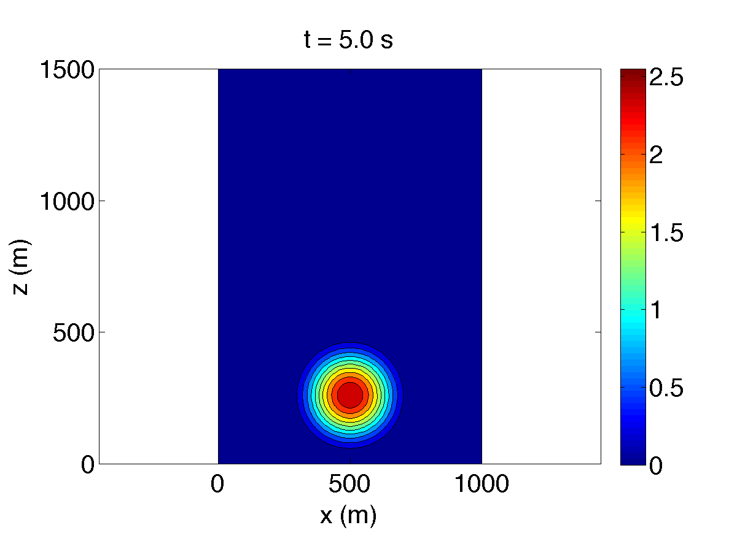
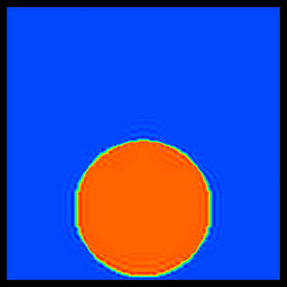
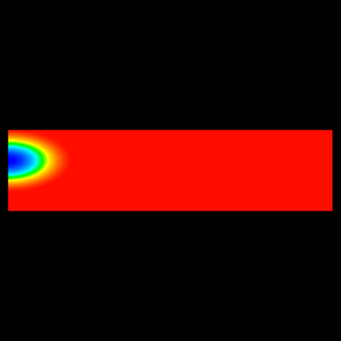

Basic Test Cases
Smooth Bubble (3D)
(Non-Smooth) Robert Bubble
Density Current w/50 m resolution and 10th order polynomials

Slide 20
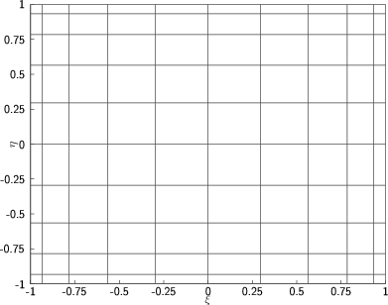
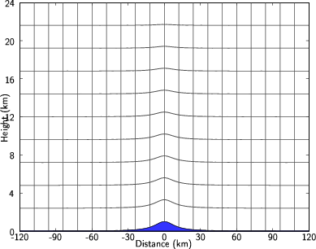
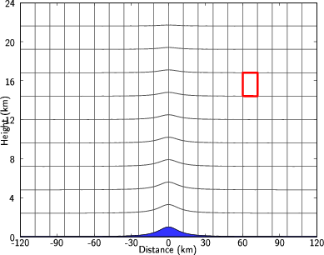
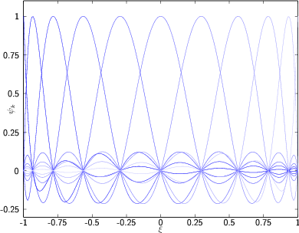
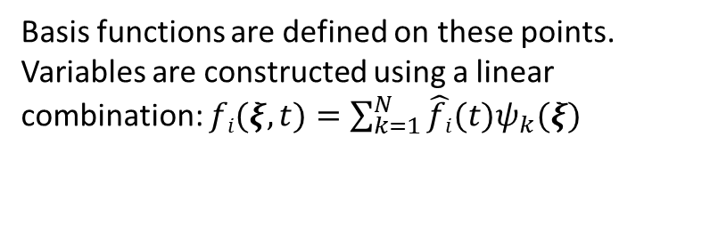
Element Based Galerkin Method
Background
Decompose the computational domain into elements in both horizontal and vertical direction (20 and 10, respectively in this 2D example).
Each element is transformed onto an element.
Within each element there are non-uniformly spaced interpolation (nodal) points (example for N=10, i.e., 10th order function).
Basis functions are defined on these points. Variables are constructed using a linear combination: $fi(ξ,t)=\sum_{k=1}^{N}{\hat{fi}(t)ψ_{k}(ξ)}$
Solve the governing equation: $\frac{∂q}{∂t}=F\left(q\right)$, where $q(f1,f2,…)$ is the solution vector

